Slide 1
STM32 – KEYBOARD
Dr. Federica Villa

Slide 2
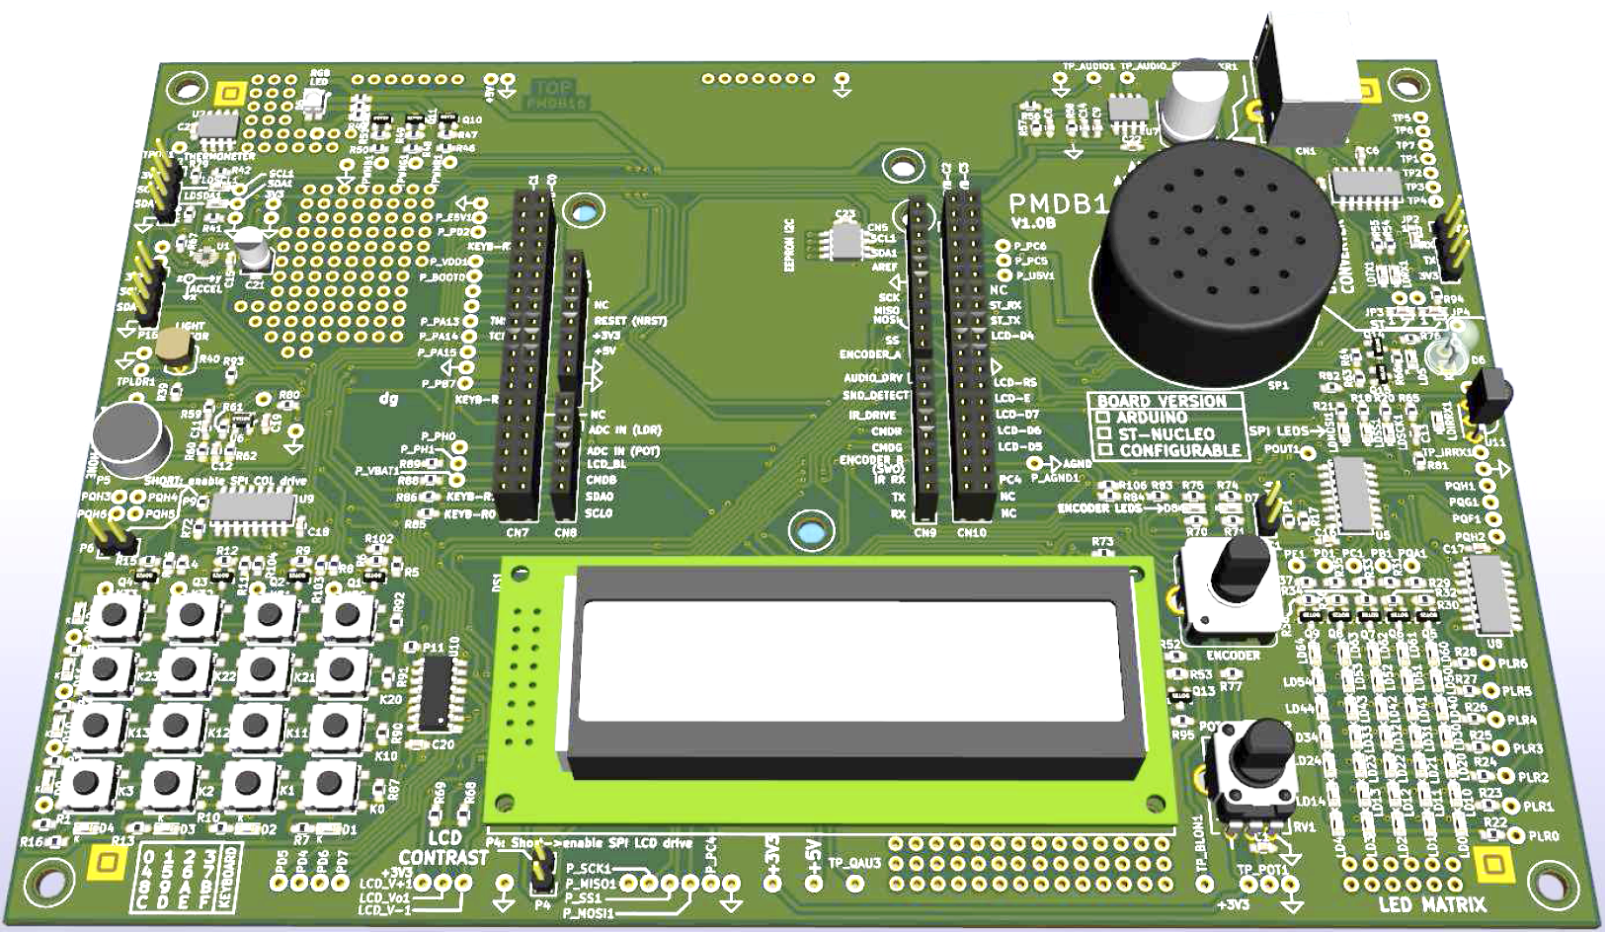
KEYBOARD– Evaluation Board Components Overview
KEYBOARD

Slide 3
KEYBOARD – PMDB16 details
KEYBOARD (4x4)
In our PMDB16 board:
U9 not mounted, instead we have P10
U10 not mounted, instead we have P11
Notes:
IN QUESTA PRIMA SEZIONE CI CONCENTRAREMO SULLA MATRICE DI LED, IN PARTICOLARE SU ALCUNI ASPETTI TECNICI E SU DEGLI ESEMPI PRATICI

Slide 4
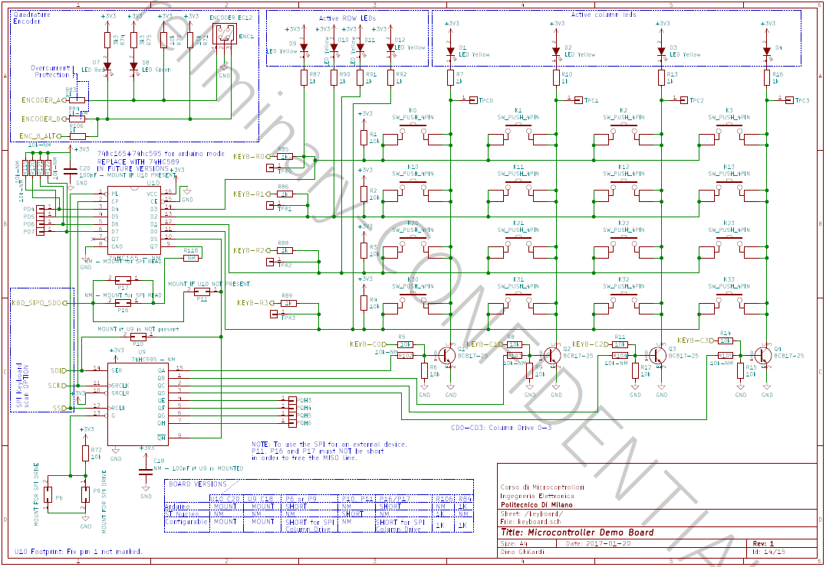
KEYBOARD – Schematic overview
KEYBOARD (4x4)
Row Readout
Not mounted
Column Driver

Slide 5
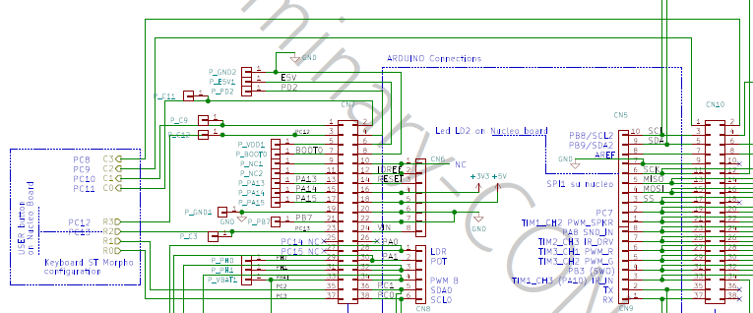
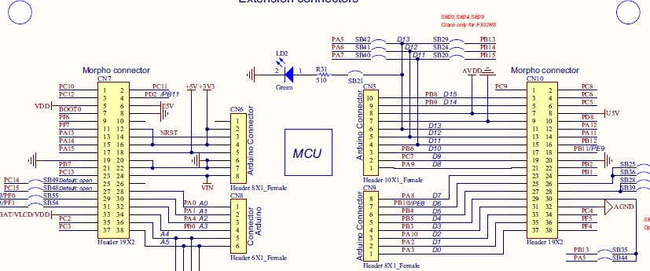
KEYBOARD – Pinout configuration
Column Driver
Row Readout
PC2
PC3
PC12
PC13
GPIO input
PC8
PC9
PC10
PC11
GPIO output

Slide 6
KEYBOARD – How to read a key
Pull-up resistors on the row lines
Open collector transistors on the column line pull it to ground or leave it floating
PRESSED
1
PRESSED
1
To read a key:
Scan periodically across the keyboard by enabling one column at a time
Read the 4 rows:
if a row is high (=‘1’) then the key is NOT pressed
Else, the key IS pressed
To debounce, wait for a minimum keypress duration before calidating the input
PRESSED
0
PRESSED
1
1
0
1
1
Z
Z
Z
Z
Z
Z
0
0

Slide 7
Project 1a - Objective
Objective
Scan each column and read the keyboard using polling

Slide 8
Project hints
Configure the 8 GPIOs required to scan the keyboard.
Within your main loop, select one column at a time, wait for a certain amount of time, then read the status of the 4 rows. Scan through all 4 columns.
For each pressed key, send the corresponding character to PC via UART. Do not repeat the key send if the key remain pressed at the following iterations. Send the code again if the key is released and pressed again.
Compile and debug the code. (Suggestion: step through each column slowly and check the code operation)

Slide 9
Project 1b - Objective
Objective
Scan each column and read the keyboard using a timer interrupt

Slide 10
Project hints
Configure the 8 GPIOs required to scan the keyboard.
Setup a timer to provide an interrupt every few ms. In the callback, acquire the status of the 4 rows and then enable a new column. Figure out a way to keep track of when each of the 16 keys is pressed and for how long.
Within the loop(), if a key is pressed long enough, send the corresponding character to PC via UART. Do not repeat the key send if the key remain pressed. Send the code again if the key is released and pressed again.
Compile and debug the code. (Suggestion: step through each column slowly and check the code operation)

Slide 11
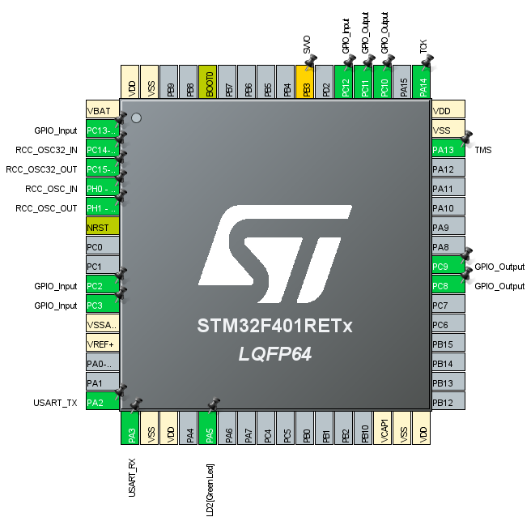
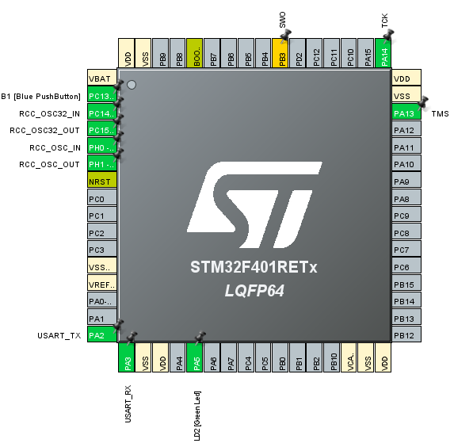
Project 1 - Setting on CUBE pinout (1)
Starting from a default model project
Select the following GPIO_input and GPIO_output ports

